Slide 1

SNC1P0

Slide 2
What is density?
Recall: Mass (g, kg) is the amount of matter an object has, volume (l, ml, cm³, m³) is the amount of space an object takes up
Density is the amount of matter per unit volume of matter
Expressed as a formula:
Density (D) = Mass (m)
Volume (V)
m
D
V

Slide 3

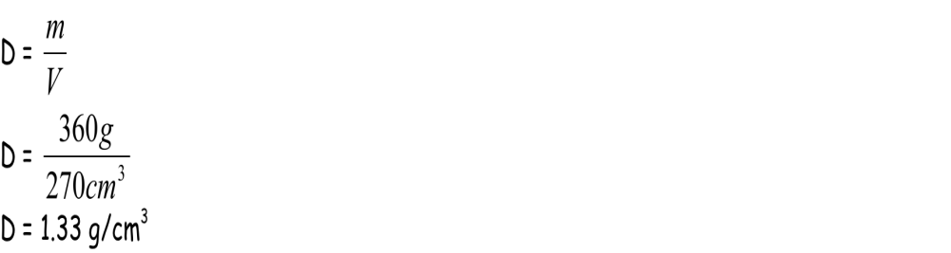
Example 1
A softball has a mass of 360g and a volume of 270 cm³. Find the density.
Given:
    Mass, m = 360 g
    Volume, V = 270 cm³
Required:
    Density (D) = ?
Analysis:
    D = m
    V
Solve:
Paraphrase: The density of the softball is 1.33 g/cm³.

Slide 4
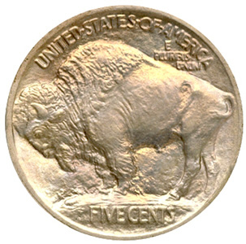
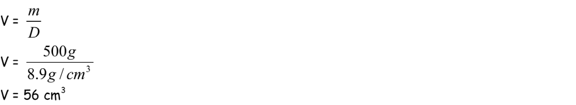
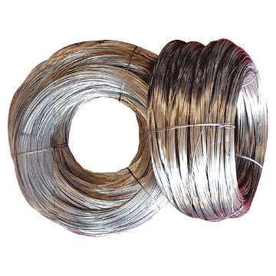
Example 2
The density of nickel is 8.9 g/cm³. What is the volume of 500 g of nickel?
Given:
    D = 8.9 g/cm³
    m = 500 g
Required:
    V = ?
Analysis:
    V = m
    D
Solve:
Paraphrase: A 500 g sample of nickel has a volume of 56 cm³.

Slide 5
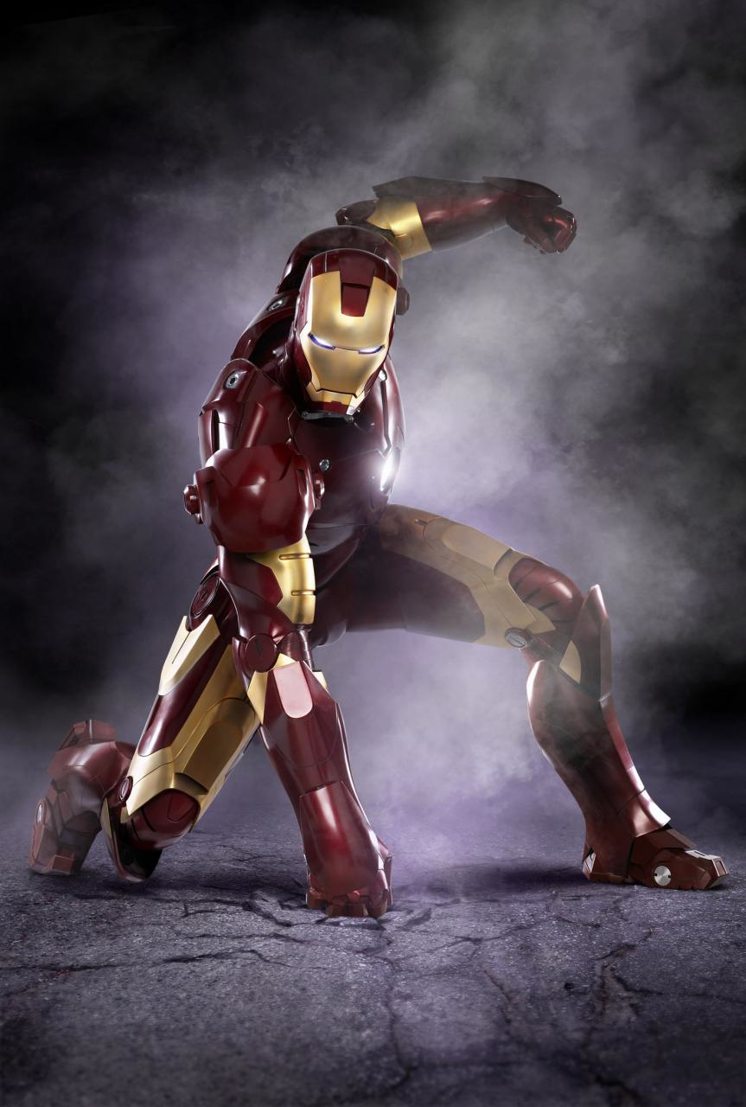
Example 3 Con’t
Solve:
  Conversion of volume from m³ to cm³
    1 m³ rewritten as 1 m x 1 m x 1m
    1 m = 100 cm
    1 m³ can be rewritten as 100 cm x 100 cm x 100 cm or 1 000 000 cm³.
  Calculation of mass
    m = DV
    = 7,9 g/cm³ x 1 000 000 cm³
    = 7 900 000 g
    = 7 900 kg
Paraphrase: The mass of 1.0 m³ of iron is 7900 kg.

Slide 6
Finding density
As long as you can determine the volume and mass of an object, you can determine its density
What are some ways to determine the mass of an object?
What are some ways to determine the volume of an object?

Slide 7
Density of a regular shape object
With a regular shape object, you can use a ruler to measure its dimensions and calculate its density
The volume of a cube or rectangular object is measured by:
Volume (V) = length (l) x width (w) x height (h)

Slide 8
DENSITY OF A REGULAR SOLID
m = 240 g
Find the Mass of the solid on a balance.
Measure the three lengths and calculate the Volume.
(ie V = l x w x h )
Calculate the Density.
2.0 cm
D = m = 240 =10.0 g/cm³
V 24
3.0 cm
4.0 cm

Slide 9
DENSITY OF AN IRREGULAR SOLID
DISPLACEMENT METHOD
1)Small irregular solids 2)Large irregular solids (use an overflow can)

Slide 10

1) SMALL IRREGULAR SOLID
m = 360 g
D = m = 360 =12.0 g/cm³
V 30
Find the Mass of the solid on a balance.
Fill the Measuring Cylinder with Water to a known Volume.
Add the Object.
Work out the Volume of Water that is displaced.(V2-V1)80-50=30mL
Calculate the Density.
V2=80 cm³
V1=50 cm³

Slide 11
2) LARGE IRREGULAR SOLID
Use an Overflow Can to find the Volume.
Find the mass of the solid on a balance.
Add water until just overflowing.
Place a Measuring Cylinder under the spout.
Add the Object.
Collect the Water and read off the Volume.
Calculate Density
m = 440 g
40.0 cm³
D = m = 440 =11.0 g/cm3
V 40

